Slide 1

Stack Overflow Survey: Current & Future Tech Trends
Phillip Knutzen - 7th Nov. 2025

Slide 2
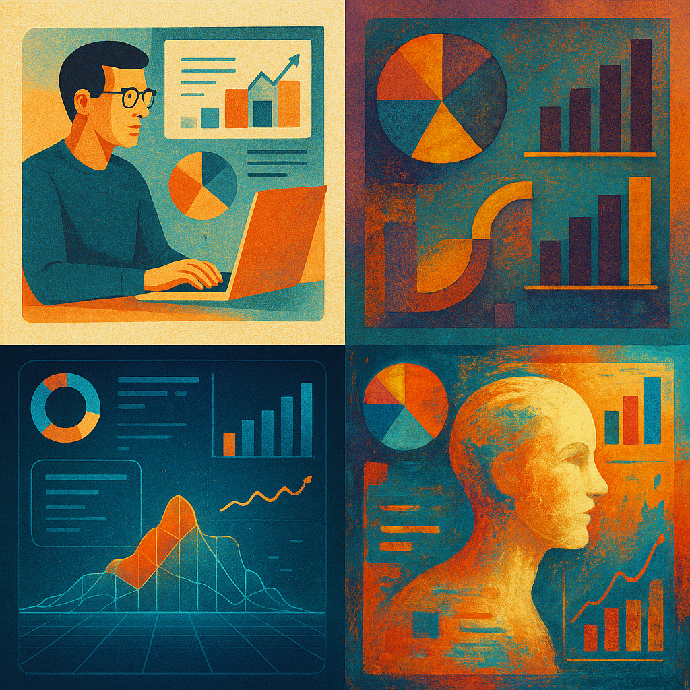


OUTLINE
1 Executive Summary
2 Introduction
3 Methodology
4 Programming Language Trends
5 Database Trends
6 Platform & Framework Trends
7 Dashboards
8 Current Technology Usage
9 Future Technology Trends
10 Demographics
11 Insights from Dashboards
12 Overall Findings & Implications
13 Conclusion
14 Appendix

Slide 3
EXECUTIVE SUMMARY
This project analyzes the Stack Overflow Developer Survey 2024 to identify current and emerging technology trends among developers worldwide
Survey data was visualized to compare the most used and most desired programming languages, databases, and platforms.
This presentation provides a concise overview of developer preferences and future skill demand
Key Findings:
JavaScript, Python, and SQL remain foundational languages across industries.
TypeScript and Rust continue to gain traction among professional developers.
PostgreSQL has overtaken MySQL as the leading database.
AWS and React dominate their respective categories, reflecting the ongoing influence of the JavaScript ecosystem and cloud-first development
Thank you, please enjoy the presentation!

Slide 4
INTRODUCTION
Purpose of this Analysis:
examine developer technology adoption patterns and predict short-term shifts in usage and interest
Relevance:
by comparing current usage with technologies developers plan to learn next, this analysis reveals where future investment and skill development should focus
Scope:
covers programming languages, databases, frameworks, and cloud platforms, along with demographic factors influencing technology choice.

Slide 5

METHODOLOGY
Data Source
Stack Overflow Developer Survey 2024, featuring responses from over 18,000 developers worldwide.
Key variables: language, database, platform, framework usage, and demographics.
Data Preparation
Cleaned and standardized categorical variables.
Separated multi-value responses by commas to isolate individual technologies for accurate frequency analysis
Filtered incomplete entries and normalized percentage distributions.
Combined “currently used” and “desired to learn” data to compare present and future trends
Tools and Process
Python (Pandas, NumPy) for data analysis
IBM Cognos Analytics for interactive dashboard visualization.
PowerPoint (IBM Skills Network template) for structured reporting
Analytical Focus
Rank top 10 technologies by current and projected popularity
Examine relationships between technology adoption and demographic factors
Highlight actionable insights for workforce development and future strategies

Slide 6
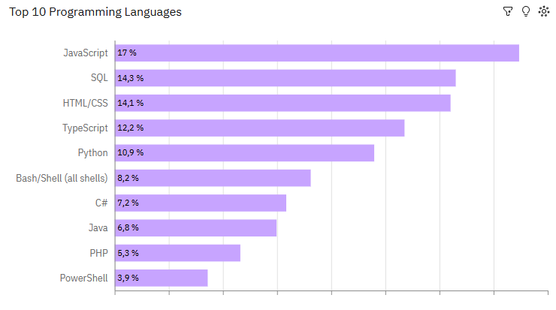
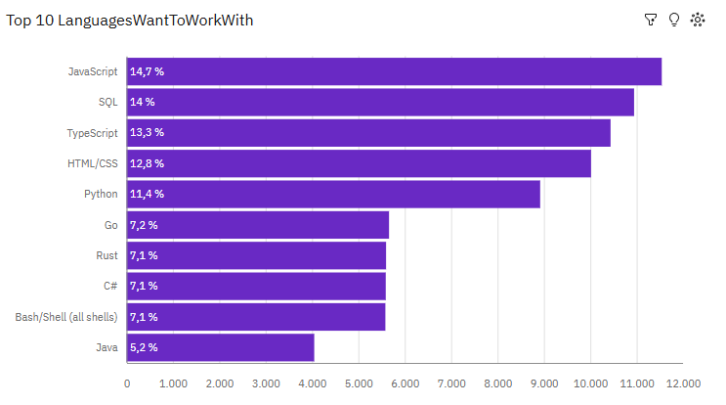
PROG LANGUAGE TRENDS (now & future)
Current Year
Next Year
<Bar chart of top 10 programming languages for the current year goes here.>

Slide 7
PROGRAMMING LANGUAGE TRENDS - FINDINGS & IMPLICATIONS
Findings
JavaScript, Python, and SQL remain the three most commonly used languages, forming the foundation of both web and data-driven development
TypeScript shows a strong upward trend, reflecting the demand for type safety and scalability in large JavaScript-based projects
Rust and Go are gaining adoption, indicating growing interest in performance-oriented and memory-safe solutions
Implications
Core skills remain highly relevant The continued popularity of JavaScript, Python, and SQL shows that learning these languages is still essential for most development roles.
Continuous learning is the norm The mix of old and new languages in demand suggests that developers must keep updating their skills to stay competitive.
Accessibility drives adoption Python’s continued strength suggests that approachable, easy to learn languages help bring new developers into the field and support a wide range of applications

Slide 8
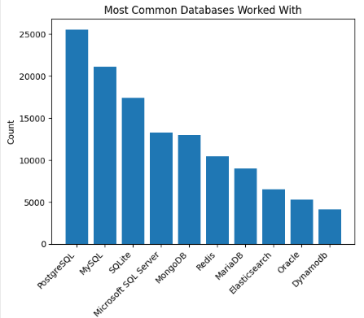
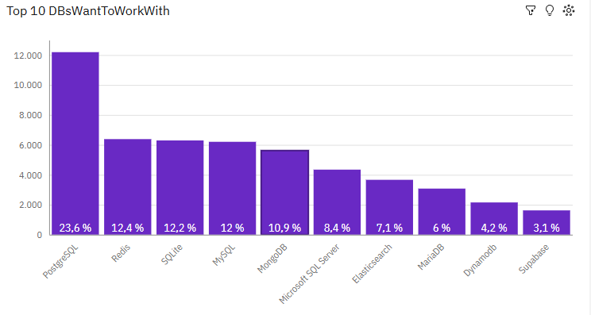
DATABASE TRENDS (now & future)
Current Year
Next Year
< Bar chart of top 10 databases for the current year goes here >
< Bar chart of top 10 databases for the next year goes here.>

Slide 9
DATABASE TRENDS - FINDINGS & IMPLICATIONS
Findings
PostgreSQL has overtaken MySQL as the most widely used database
SQLite remains popular for lightweight and embedded applications
Microsoft SQL Server and Oracle remain staples in enterprise environments
Implications
Open-source adoption is growing PostgreSQL’s rise shows developers and organizations increasingly prefer free, community-driven tools over proprietary systems.
Traditional databases will persist Systems like MySQL and SQL Server remain vital for legacy support and structured data, even as newer tools gain ground.
*

Slide 10
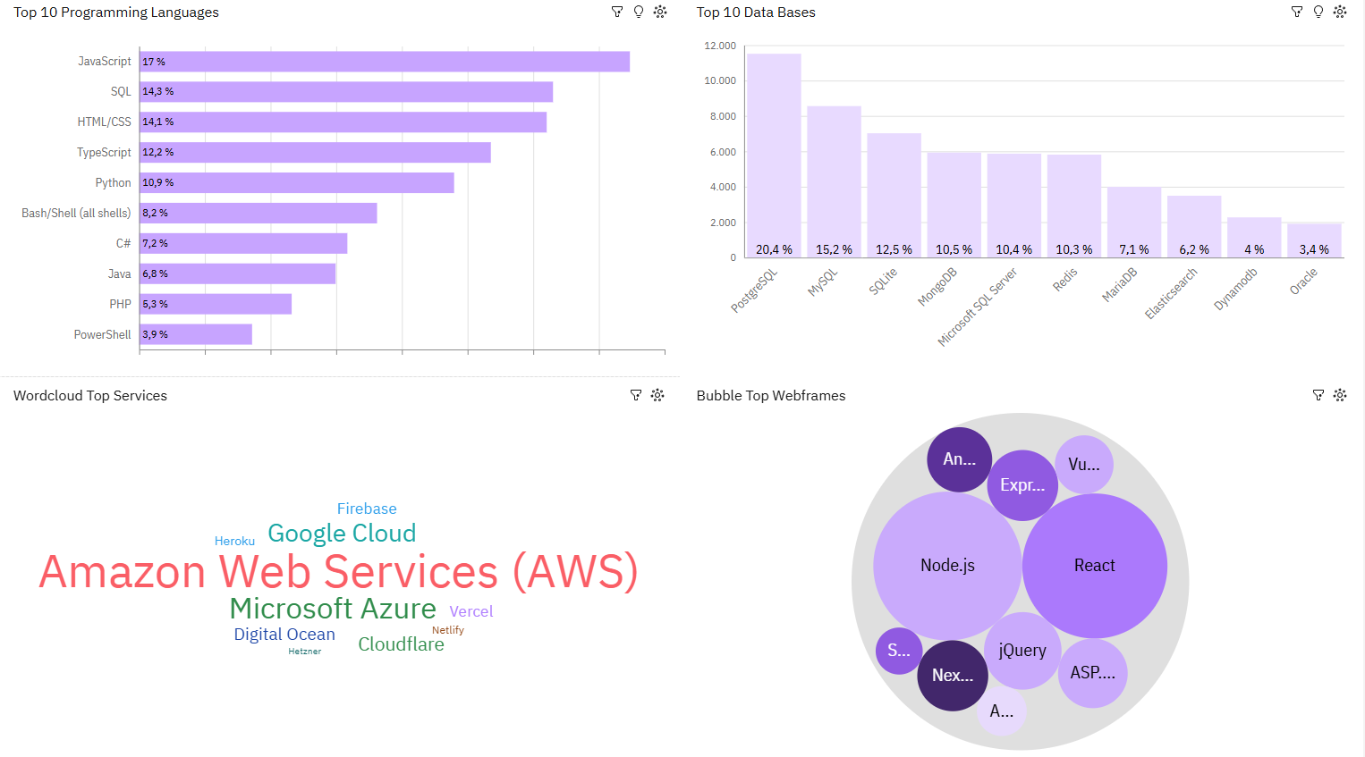
DASHBOARD TAB 1
Screenshot of dashboard tab 1 goes here

Slide 11
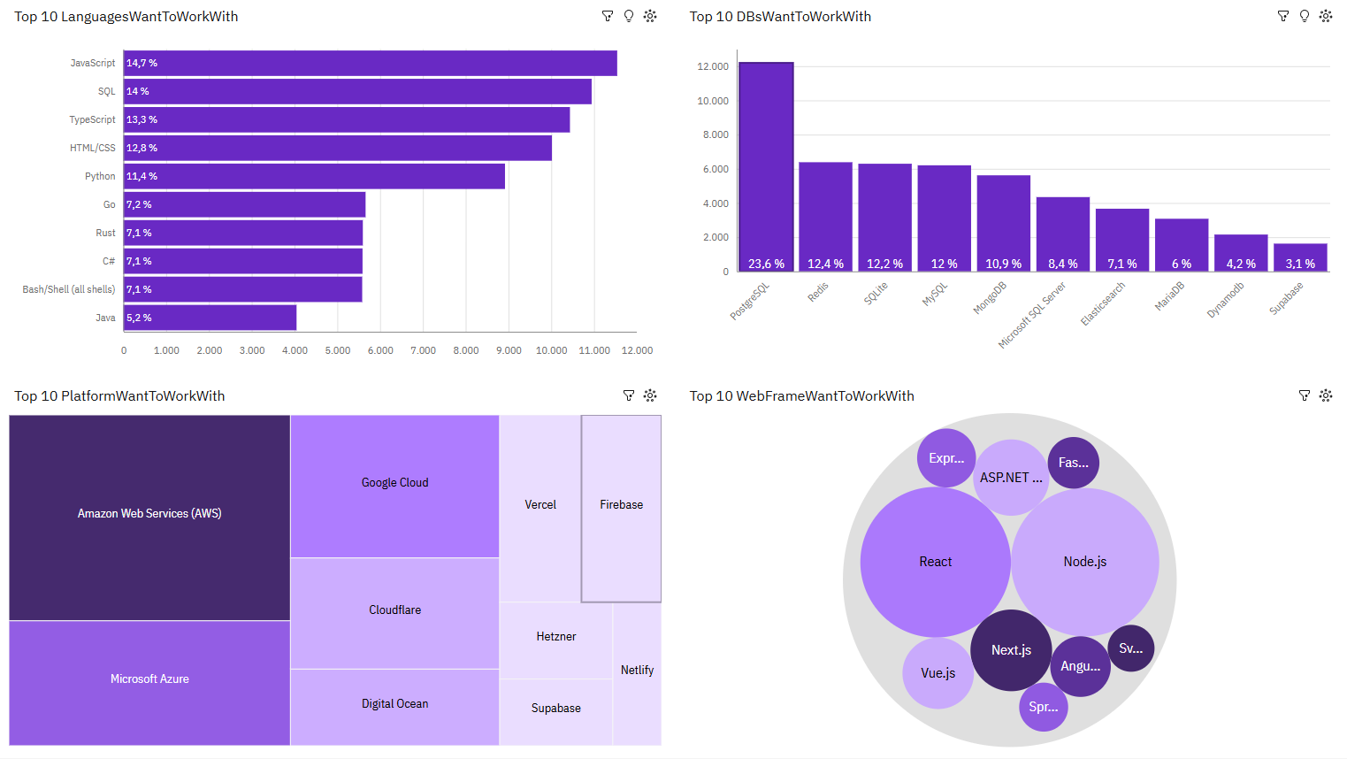
DASHBOARD TAB 2
Screenshot of dashboard tab 2 goes here

Slide 12
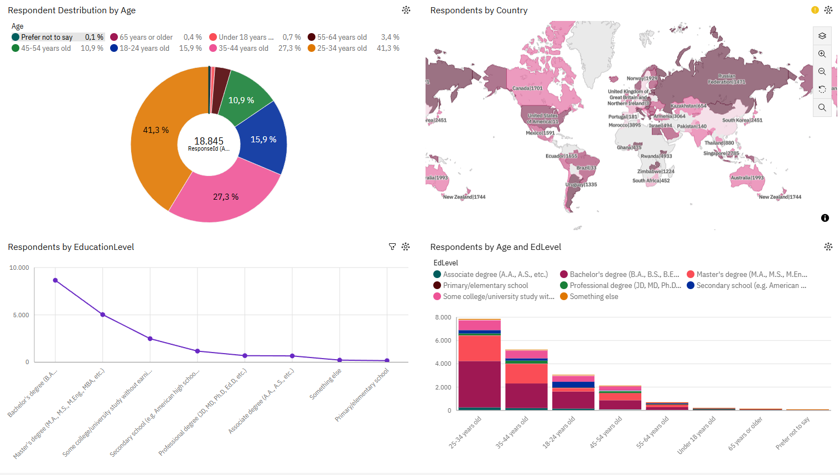
DASHBOARD TAB 3
Screenshot of dashboard tab 3 goes here

Slide 13
OVERALL FINDINGS & IMPLICATIONS
Findings
Developers continue to rely on core technologies
JavaScript, Python, and SQL dominate across all levels of experience
PostgreSQL has become the preferred database,
signaling the rise of powerful open-source solutions.
TypeScript, Rust and Go show increasing adoption,
reflecting a shift toward performance, safety, and maintainability
Cloud platforms like AWS, Azure and Google Cloud remain essential,
but lightweight services (Firebase, Supabase) are gaining traction
Implications
Core skills remain a priority:
Learning JavaScript, Python, and SQL continues to offer the broadest career opportunities.
Open-source and cloud adoption will accelerate, driven by accessibility and flexibility.
Developer preferences evolve with experience
younger professionals experiment with emerging tools, while older experts favor proven stability.
Continuous learning is essential
to adapt to fast-changing technologies and maintain competitiveness in the tech industry.

Slide 14
CONCLUSION
The survey results show that developers rely on a few key languages and databases that have proven reliable and widely supported
JavaScript, Python, and SQL continue to be the main tools used across most types of development work
PostgreSQL stands out as the most trusted database, showing a general move toward open and flexible systems
At the same time, newer tools like TypeScript, Rust, and Go are gaining attention as developers look for more efficient and modern options
Overall, the data suggests a balanced industry one that values both stable, well-known technologies and careful exploration of newer ones

Slide 15
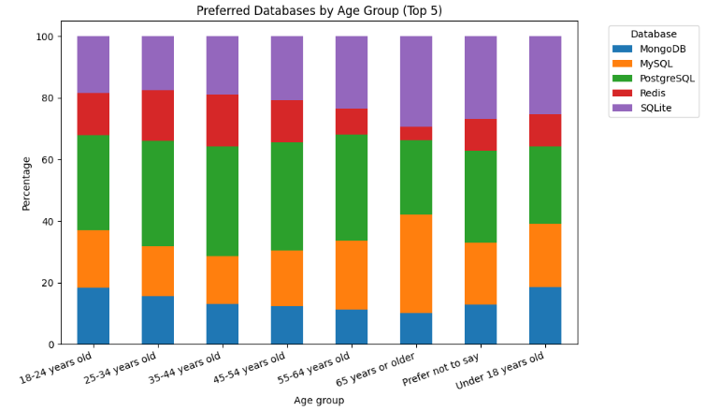

APPENDIX, extra, stacked chart
The chart shows that database choices differ slightly by age group.
Younger developers tend to favor newer and more flexible systems like MongoDB and Redis, while older developers prefer established SQL databases such as PostgreSQL and MySQL.

Slide 16
Thank you for your attention!

